Slide 1
The State of Ethics in Computer Science
Jared Moore
Wadhwani Institute for Artificial Intelligence

Slide 2
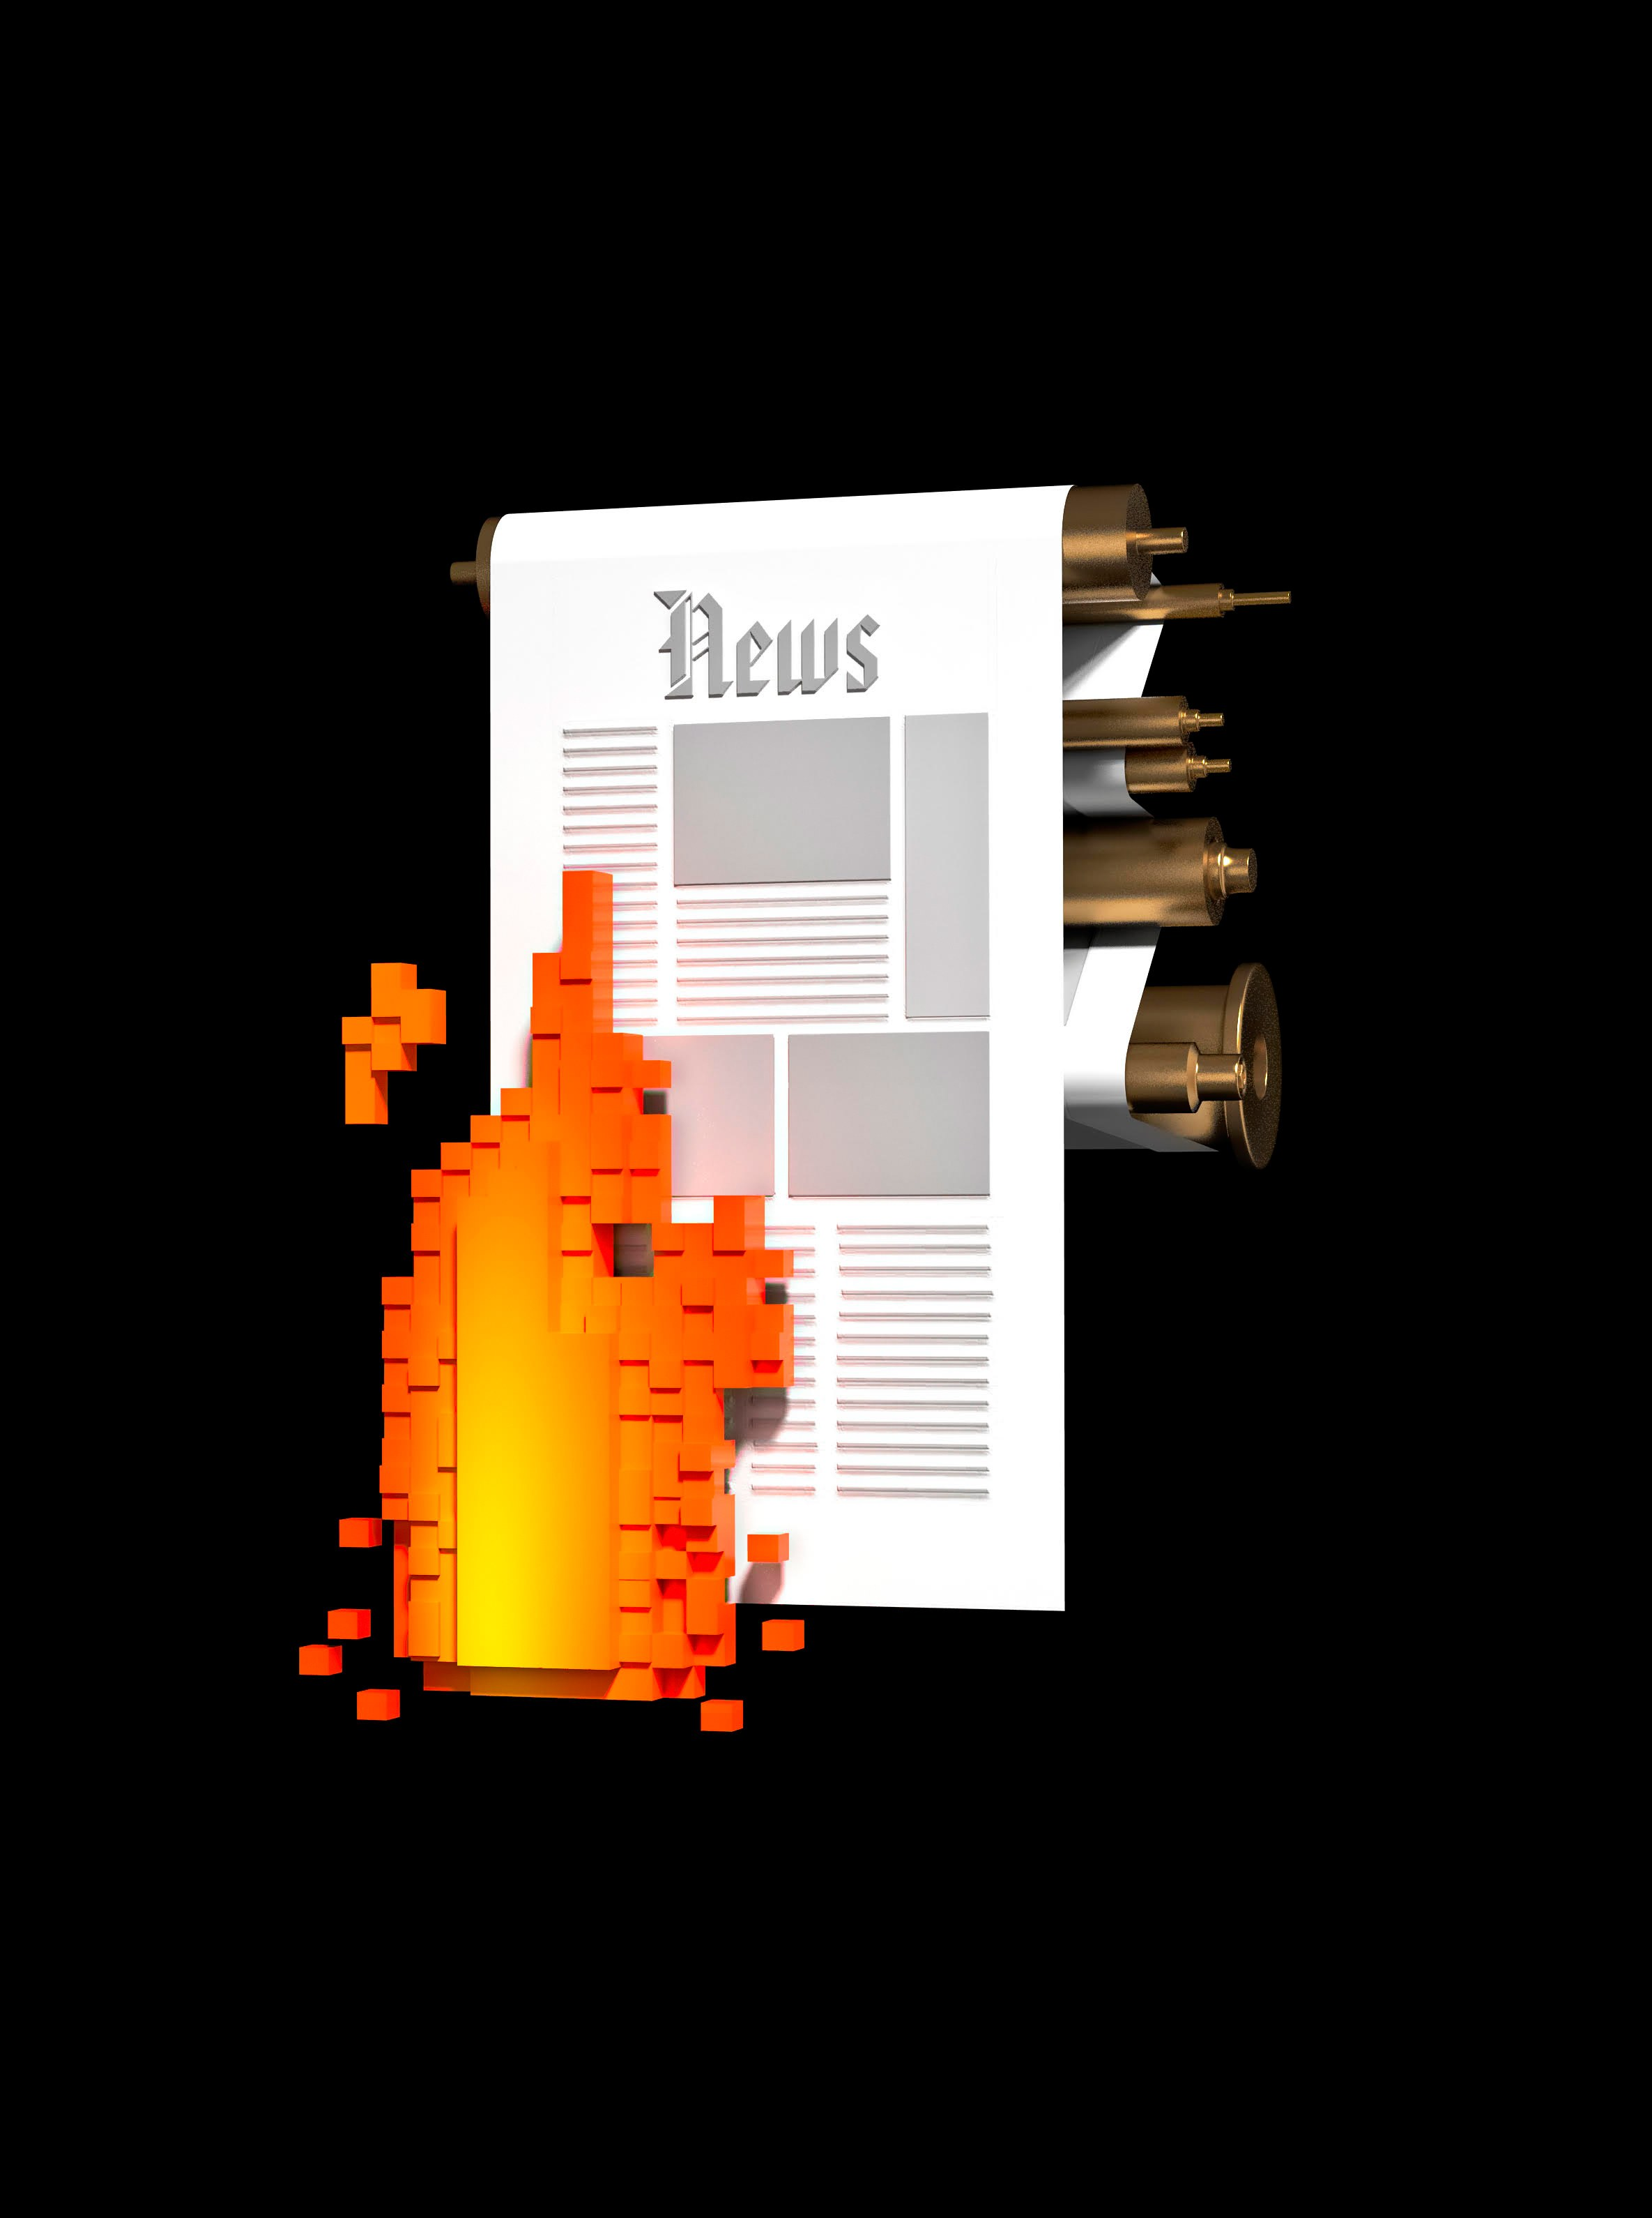
Fake news on Facebook during 2016 U.S. presidential election. paid for by Russians
Widely agreed that this influenced the election
But Zuckerberg said this was “a pretty crazy idea”
N. T. Vogelstein Fred, “Inside Facebook’s Two Years of Hell,” Wired, 12-Feb-2018.
Notes:
Not just Facebook as a corporate entity but literally the manners with which the Facebook newsfeed algorithms displayed content
How many of you heard about this?
Use facebook?
Do we agree that this is a significant impact of technology on society?

Slide 3
Fake news on Facebook during 2016 U.S. presidential election. paid for by Russians
Widely agreed that this influenced the election
But Zuckerberg said this was “a pretty crazy idea”
N. T. Vogelstein Fred, “Inside Facebook’s Two Years of Hell,” Wired, 12-Feb-2018.
Notes:
Not just Facebook as a corporate entity but literally the manners with which the Facebook newsfeed algorithms displayed content
How many of you heard about this?
Use facebook?
Do we agree that this is a significant impact of technology on society?

Slide 4
Framing History Now Direction

Slide 5
ethics

Slide 6
Husserl
Nietzsche
deontology
standards
Kant
utilitarianism
ethics
navel-gazing
Aristotle
trolley problem
values
social impacts
professionalism

Slide 7
ethics

Slide 8
How do you convince someone about the importance of privacy who doesn’t believe in it?
Can we hold technical systems to a higher standard than we would human systems?
Does an employee’s opinion matter if it would negative affect the bottom line?
Notes:
These are questions that the change audience asks themselves all of the time
One of the few groups for whom a consideration of ethics is core to the research area

Slide 9
ethics

Slide 10
ethics
a) An intentional approach to address human debates
b) A shorthand to discuss values like
privacy
ownership
expression
accountability
justice
etc.
Notes:
Yes this means I am suggesting a kind of relativism
Officially:
ethics: moral principles that govern a person's behavior or the conducting of an activity

Slide 11
Framing History Now Direction

Slide 12
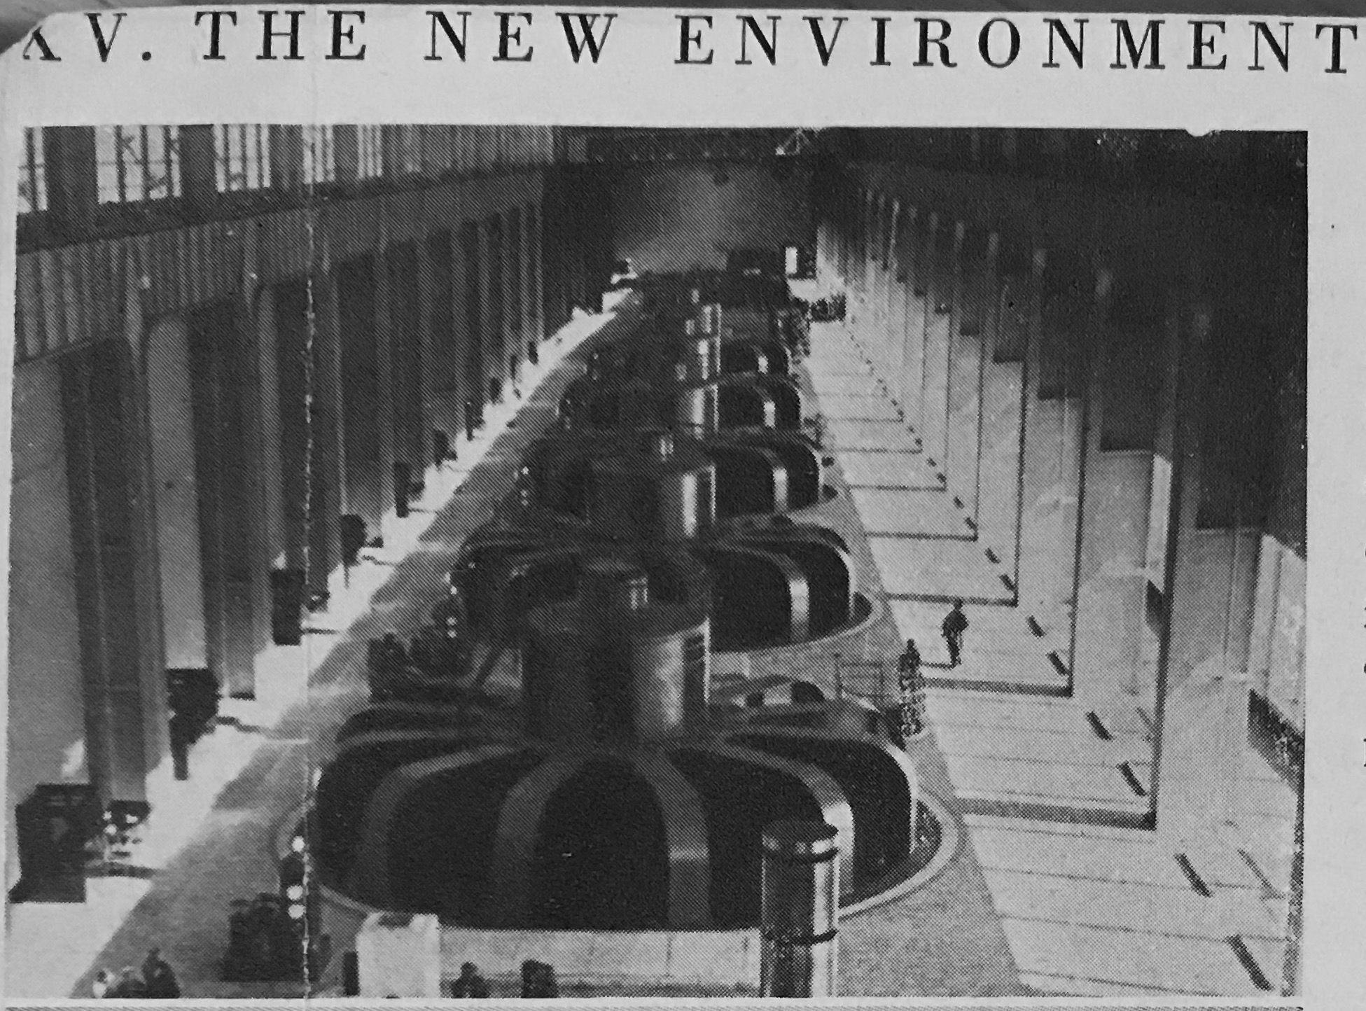
“He [sic] who does not see choice in the development of the machine merely betrays his incapacity to observe cumulative effects until they are bunched together so closely that they seem completely external and impersonal”
L. Mumford, Technics and civilization. University of Chicago Press, 2010.

Slide 13

First Era
Technology
1940s, late; big computers
Computer Ethics
1948 Cybernetics (Wiener)
Science and Technology Studies
1934 Technics and Civilization (Mumford)
1954 The Technological Society (Ellul)
Notes:
First wave; the prospects of computers
Explain science and technology studies
Photo:
https://en.wikipedia.org/wiki/File:Eniac.jpg

Slide 14
First Era
“The measures taken during the war by our military agencies, in restricting the free intercourse among scientists on related projects or even on the same project have gone so far that it is clear that if continued in time of peace, this policy will lead to the total irresponsibility of the scientist, and, ultimately, to the death of science. ...The interchange of ideas, which is one of the greatest traditions of science, must of course receive certain limitations when the scientist becomes an arbiter of life and death. ...I do not expect to publish any future work of mine which may do damage in the hands of irresponsible militarists...”
"A Scientist Rebels" Atlantic Monthly (Jan, 1947)
Notes:
First wave; the prospects of computers
Explain science and technology studies
Photo:
https://en.wikipedia.org/wiki/File:Eniac.jpg

Slide 15
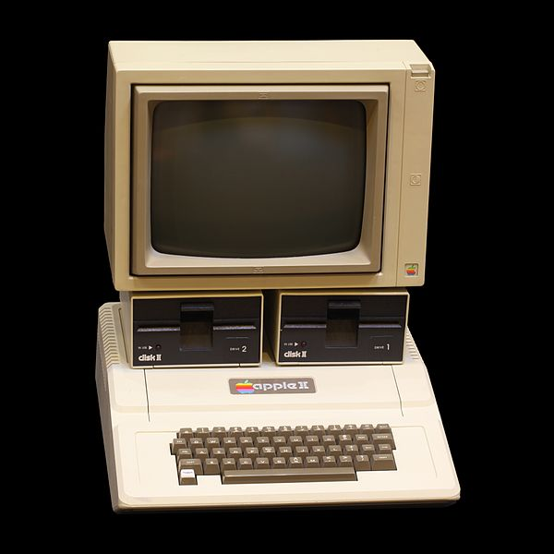
Second Era
Technology
1970s, mid; micro-computers
1980s, early; Big software
Computer Ethics
1976 Computer Power… (Weizenbaum)
1985 What is Computer Ethics? (Moor)
1985 Computer Ethics (Johnson)
Science and Technology Studies
1975 The History of Sexuality (Foucault)
1980 Do artifacts have politics (Winner)
1986 Laboratory Life (Latour & Woolgar)
Organizations
1983 Computer Pro’s for Social Responsibility
Legislation
1985 Computer Fraud and Abuse Act
1986 Electronic Communications Privacy Act
Notes:
second wave; proliferation of software
Image:
https://commons.wikimedia.org/wiki/File:Apple_II_IMG_4212.jpg

Slide 16
Second Era
“A typical problem in computer ethics arises because there is a policy vacuum about how computer technology should be used. Computers pro vide us with new capabilities and these in turn give us new choices for action. Often, either no policies for conduct in these situations exist or existing pol cies seem inadequate. A central task of computer ethics is to determine what we should do in such cases, i.e., to formulate policies to guide our actions. Of course, some ethical situations confront us as individuals and some as a society. Computer ethics includes consideration of both personal and social policies for the ethical use of computer technology”
J. H. Moor, “What Is Computer Ethics?*,” Metaphilosophy, vol. 16, no. 4, pp. 266–275, 1985.
Notes:
second wave; proliferation of software
Image:
https://commons.wikimedia.org/wiki/File:Apple_II_IMG_4212.jpg

Slide 17

Third Era
Technology
1990s; Internet
Computer Ethics
1997 Human Values… (Friedman)
1997 ACM and IEEE codes of ethics
Science and Technology Studies
1991 Feminism confronts technology (Wajcman )
Organizations
1990 Electronic Frontier Foundation
1990s ACM SIGCAS
Legislation
1998 Children’s Online Privacy Protection Act
Notes:
Third wave; rise of the internet
Something about colonialism and technology?
Image:
https://en.wikipedia.org/wiki/File:America_Online_logo.svg

Slide 18
Third Era
“Specific purposes and interests of domination are not foisted upon technology "subsequently" and from the outside; they enter the very construction of the technical apparatus. Technology is always a historical-social project: in it is projected what a society and its ruling interests intend to do with men and things. Such a "purpose" of domination is "substantive" and to this extent belongs to the very form of technical reason.‎”
J. Wajcman, Feminism confronts technology. Penn State Press, 1991.
Notes:
Third wave; rise of the internet
Something about colonialism and technology?
Image:
https://en.wikipedia.org/wiki/File:America_Online_logo.svg

Slide 19
Aside:
Are the trends we see in computer science unique?
Notes:
https://cns.asu.edu/about/history
Computer scientists, computer engineers, data scientists…
Are not unique
Physicists
Cryptographers
This is just what happens with older technologies

Slide 20

The 2000s saw…
Ethical legal and social impacts (ELSI)
Aside:
Are the trends we see in computer science unique?
“The 21st Century Nanotechnology Research and Development Act…mandated the integration of research on societal, ethical and environmental concerns with nanotechnology research and development”
Notes:
https://cns.asu.edu/about/history
Computer scientists, computer engineers, data scientists…
Are not unique
Physicists
Cryptographers
This is just what happens with older technologies

Slide 21
Framing History Now Direction

Slide 22
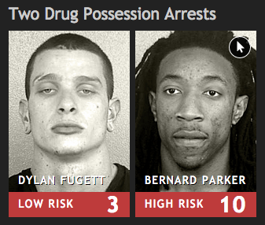
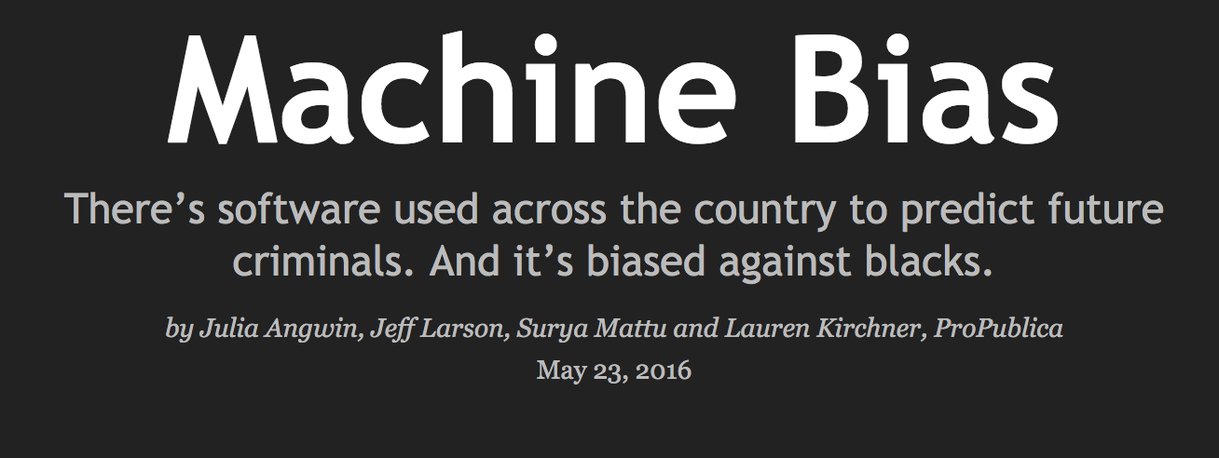
Notes:
https://www.propublica.org/article/machine-bias-risk-assessments-in-criminal-sentencing
present the problems identified in the beginning:
Big tech
Surveillance capitalism
Cryptography
State surveillance
AI

Slide 23
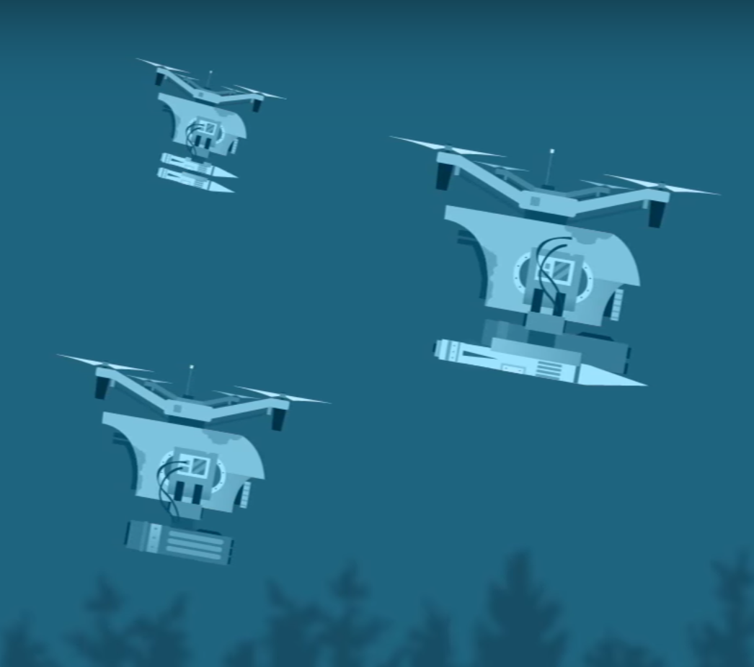
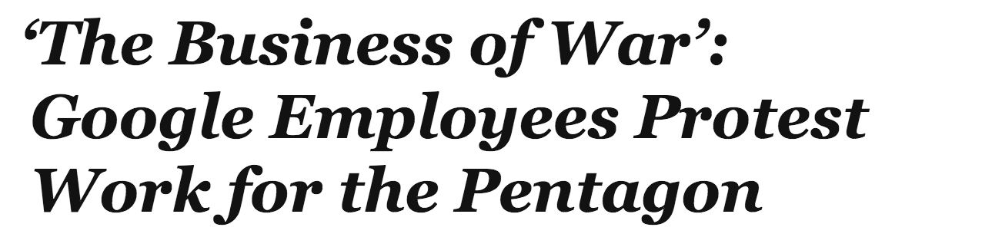

Notes:
And general defense contracts
Google projects Maven & Dragonfly
Amazon… which ones?
https://www.nytimes.com/2018/04/04/technology/google-letter-ceo-pentagon-project.html

Slide 24
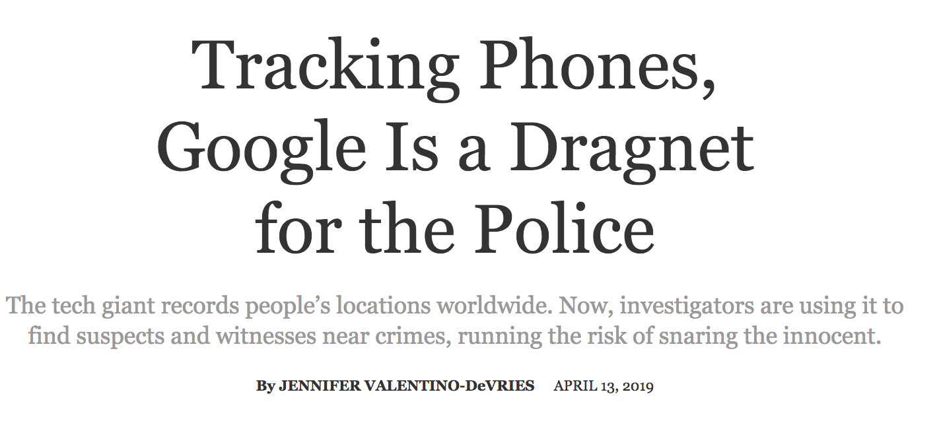
Notes:
https://www.nytimes.com/interactive/2019/04/13/us/google-location-tracking-police.html

Slide 25
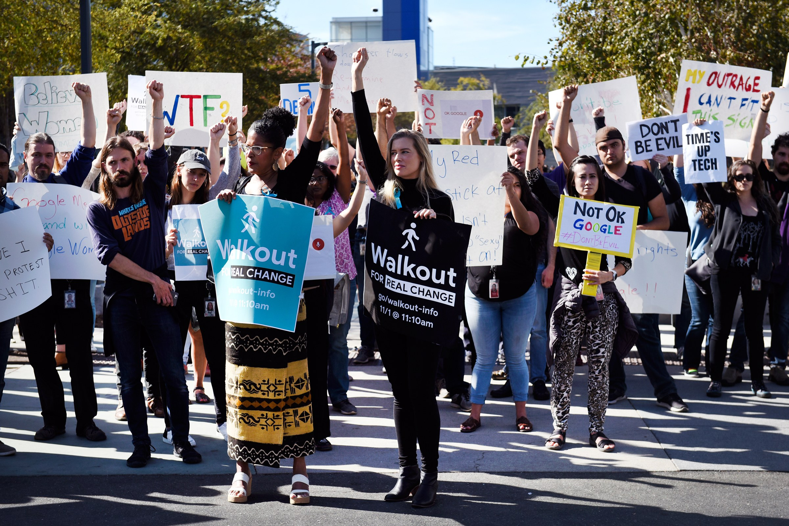
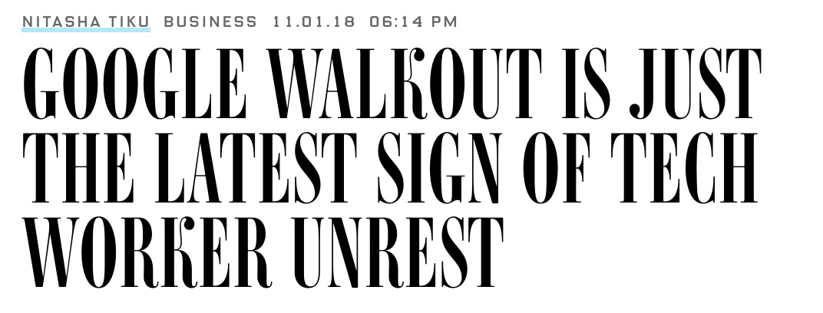
Notes:
https://www.wired.com/story/google-walkout-just-latest-sign-tech-worker-unrest/

Slide 27

Notes:
Trying to find the signal in the noise
https://i.ytimg.com/vi/7HpMnOcvfS4/maxresdefault.jpg

Slide 28
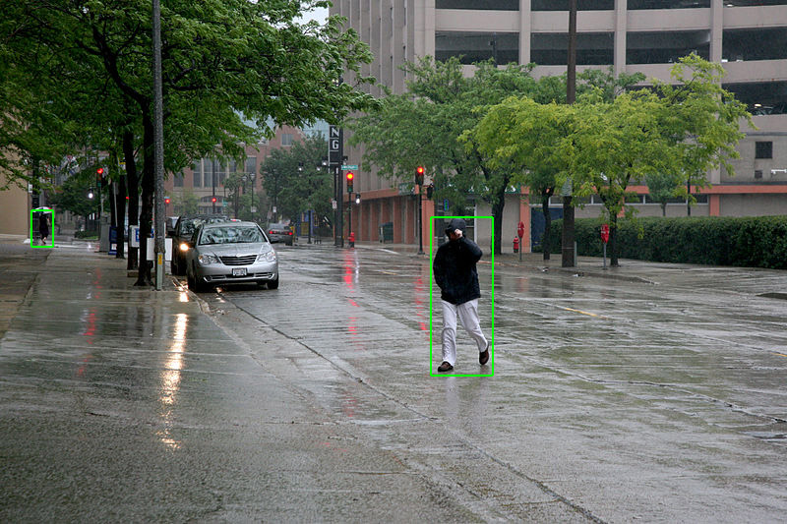
Current Era
Technology
2000s, mid; social media & smartphones
2010s, early; big AI
Computer Ethics
2014 The Ethics of Artificial Intelligence (Bostrom)
2014 Privacy, Big Data, and the Public Good (various)
2017 FAT*, 2018 ACM Compass,
….
Science and Technology Studies
2011 A New Algorithmic Identity (Cheney-Lippold)
2012 Critical questions for big data (boyd & Crawford)
…
Organizations
2017 Tech Worker’s Coalition
…
Legislation
2016 General Data Protection Rules
Notes:
For the most part, consider the proliferation of data as allowed by the internet and social media
https://en.wikipedia.org/wiki/File:D%C3%A9tection_de_personne_-_exemple_3.jpg

Slide 29
Current Era
“Dataism thrives on the assumption that gathering data happens outside any preset framework—as if Twitter facilitates microblogging just for the sake of generating “life” data—and data analysis happens without a preset purpose—as if data miners analyze those data just for the sake of accumulating knowledge about people’s behavior.”
J. Van Dijck, “Datafication, dataism and dataveillance: Big Data between scientific paradigm and ideology,” Surveillance & Society, vol. 12, no. 2, p. 197, 2014.
Notes:
For the most part, consider the proliferation of data as allowed by the internet and social media
https://en.wikipedia.org/wiki/File:D%C3%A9tection_de_personne_-_exemple_3.jpg

Slide 30
A fourth response to questions of:
Ownership
Responsibility
Accountability
Access
Fairness
Decision rights
Technological determinism
Socio-technical systems
…
Notes:
Most of these ideas are very old…. Why does it matter?

Slide 31
Framing History Now Direction

Slide 32

Icons made Freepik https://www.flaticon.com
ethics
Notes:
One lever…

Slide 33

Icons made Freepik https://www.flaticon.com
market forces
activism
ethics
regulation
education
tech. capability
Notes:
Out of many:
That channel different values, groups of people, etc. That’s the point.
We can’t expect that by having engineers who can talk about ethics that we arrive somewhere we want, but it does help

Slide 34
Icons made Freepik https://www.flaticon.com
market forces
activism
regulation
education
tech. capability
ethics
Notes:
Some call out ethics as it would white wash the discussion
-> be too loud with regard to the other levers, obfuscate them.

Slide 35
Icons made Freepik https://www.flaticon.com
market forces
activism
regulation
education
tech. capability
ethics
Notes:
but it still has a role

Slide 36
ethics means exploring agency
Speaking out
Choosing employers
Building in constraints
Administrative discretion
Quitting
Boycotting
Petitions and open letters

Slide 37
ethics means exploring agency based on one’s values
Speaking out
Choosing employers
Building in constraints
Administrative discretion
Quitting
Boycotting
Petitions and open letters
Notes:
I certainly have my own set of values...but I’m not expecting that everyone shares it

Slide 38

Facebook changed
Newsfeed algorithm now favors friends more than articles
“the place that you can put the most pressure on the [tech] executives comes from the engineers” Wired editor on the change
Notes:
https://newsroom.fb.com/news/2018/01/news-feed-fyi-bringing-people-closer-together/
Internally, his employees disagreed, worrying about Facebook becoming an Uber-like pariah. Through complaints, employees led Zuckerberg to change course: the newsfeed algorithm switched from favoring inflammatory stories–clickbait–to focusing on friends

Slide 39
Facebook changed
Newsfeed algorithm now favors friends more than articles
“the place that you can put the most pressure on the [tech] executives comes from the engineers” Wired editor on the change
Notes:
TPS
Internally, his employees disagreed, worrying about Facebook becoming an Uber-like pariah. Through complaints, employees led Zuckerberg to change course: the newsfeed algorithm switched from favoring inflammatory stories–clickbait–to focusing on friends

Slide 40
AI Now, Stanford Human AI, conferences, etc.
Tech Worker’s Coalition,
#TechWontBuildIt
Mozilla Ethics Grant (+many courses)
IEEE AI ethics standards, PAI
General Data Protection Rules
(+many local proposals)
Where’s the pressure?
Notes:
Many of us are computing professionals
Values, and discussions about them, undergird our work
To realize one set of values (say climate justice) you might want to be systematic about knowing which levers to pull and what has happened with them before

Slide 41
AI Now, Stanford Human AI, conferences, etc.
Tech Worker’s Coalition,
#TechWontBuildIt
Mozilla Ethics Grant (+many courses)
IEEE AI ethics standards, PAI
General Data Protection Rules
(+many local proposals)
-> research, activism
-> tech. capability, activism
-> education
-> self-regulation
-> regulation
Where’s the pressure?
Notes:
Many of us are computing professionals
Values, and discussions about them, undergird our work
To realize one set of values (say climate justice) you might want to be systematic about knowing which levers to pull and what has happened with them before

Slide 42
AI Now, Stanford Human AI, conferences, etc.
Tech Worker’s Coalition,
#TechWontBuildIt
Mozilla Ethics Grant (+many courses)
IEEE AI ethics standards, PAI
General Data Protection Rules
(+many local proposals)
-> research, activism
-> tech. capability, activism
-> education
-> self-regulation
-> regulation
Where’s the pressure?
ethics
Notes:
Many of us are computing professionals
Values, and discussions about them, undergird our work
To realize one set of values (say climate justice) you might want to be systematic about knowing which levers to pull and what has happened with them before

Slide 43
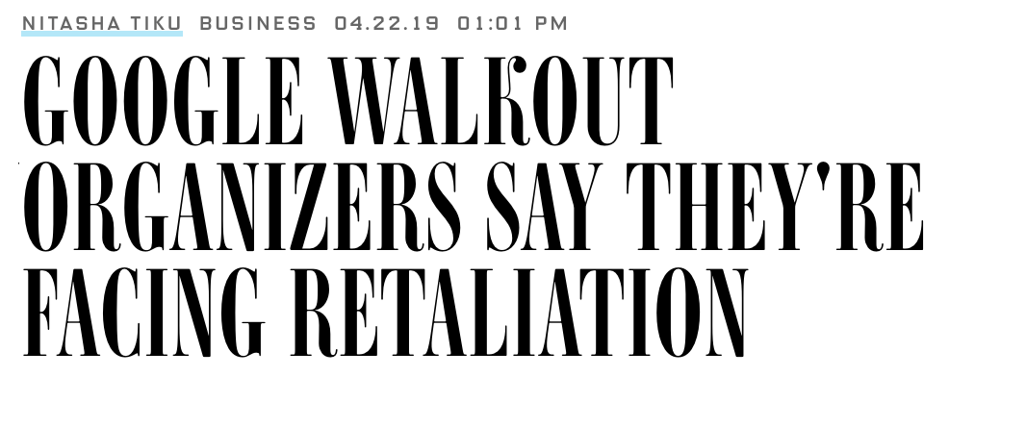
*
Notes:
https://www.wired.com/story/google-walkout-organizers-say-theyre-facing-retaliation/?mbid=social_twitter_onsiteshare

Slide 44
Notes:
There’s still static; we may not agree with all of these levers and the extent to which they have or have not been pulled
but heck it’s good to talk about values
An exciting time to be in CS

Slide 45
Thanks!
Notes:
[thank you slide; allow for clapping]

Slide 46
The State of Ethics in Computer Science
Four eras of response:
Emergence of computers
Software
Internet
(big) data analysis
Questions?
TechCrunch article on agency of engineers
Syllabus of the class I taught
Pay attention to:
Tech Worker’s Coalition
Ethics courses
(some) media
Levers available:
Ethics
Legislation
Market forces
Activism
Education
Tech. capability
Jared Moore (jared@jaredmoore.org)
Wadhwani Institute for Artificial Intelligence
Notes:
Questions? And here’s a summary

Slide 47
Devices and data:
Late1940s Big computers (ENIAC in 1946)
Mid 1970s Personal computers (Apple II in 1977)
Early 1980s Big software (Windows in 1981)
1990s Internet (World wide web in 1990)
Social media (Myspace in 2005)
Late 2000s smartphones (like iPhone in 2007)
Computer Ethics
1948 Cybernetics (Weiner)
1976 Computer Power and Human Reason (Weizenbaum)
1985 What is Computer Ethics? (Moor)
1985 Computer Ethics (Johnson)
1997 Human Values and the Design of Computer Technology (Friedman)
1997 “Software engineering code of ethics” for ACM and IEEE (Gotterbarn et al.)
Organizations
1983 Computer Professionals for Social Responsibility
1990 Electronic Frontier Foundation
1990s ACM SIGCAS
2017 Tech Worker’s Coalition
Science and Technology Studies
1934 Technics and Civilization (Mumford)
1954 The Technological Society (Ellul)
1975 The History of Sexuality (Foucault)
1980 Do artifacts have politics (Winner)
1986 Laboratory Life: (Latour and Woolgar)
1991 Feminism confronts technology (Wajcman )
Legislation
1985 Computer Fraud and Abuse Act
1986 Electronic Communications Privacy Act
1998 Children’s Online Privacy Protection Act
2016 General Data Protection Rules
Notes:
Categorize into three groups… first, second, and third wave responses in computing (and also technology)

